Slide 1

Car Game
IMS NOIDA
Under the Guidance of
Ms. Jyoti Tripathi
By-
Mohit Singh (2100980140029)

Slide 2
CONTENTS
PROJECT OVERVIEW
SOFTWARE & HARDWARE CONFIGURATION
FUTURE SCOPE & CONCLUSION
Limitations of the project
REFERENCE

Slide 3
PROJECT OVERVIEW
This project is aimed to have fun in your mondain life. Car game is basically made for the customer to have relief an anytime and anywhere offline. The user control car by touching on screen on an android phone.

Slide 4
Feasibility test
Economical Feasibility : - It is very important aspect to be considered while developing a project No money was spent in making of the game. All is available for free.
Technical Feasibility: - for running the game you need at least android 7.0 and 2 Gb RAM.
For running unity 64 bit OS, processor i3, window 7 and above is required.
Operational Feasibility: - The system is fully GUI based that is very user friendly and all inputs to be taken all self-explanatory. It is easy to understand and use.

Slide 5
SOFTWARE & HARDWARE CONFIGURATION
Hardware used: -
Intel CORE i5 9th Gen is used as a processor because it is fast, reliable and stable and we can run our pc for longtime. By using this processor, we can keep on developing our project without any worries.
Ram 8 GB is used as it will provide fast reading and writing capabilities and will in turn support in processing.
Operating system- Windows 10 is used as the operating system as it is stable and supports more features and is more user friendly.
Hardware requirement: -
2 GB RAM

Slide 6
Software used: -
Unity 2020.3.8f1 software is used to developed the project because its UI is clean and is vary stable. A lot of indie game developer uses Unity so there are a lot of content out in the internet about Unity. Unity can be used to make all shorts of games unlike Unreal which heavily focuses on very realistic AAA game.
C# is used as C# is the only language that Unity supports natively. And it is easy to use. It supports OOPS concept.
Visual Studio Code is used for coding platform.
Software requirement: -
Android 7.0+ ‘Nougat’ (API 24)

Slide 7
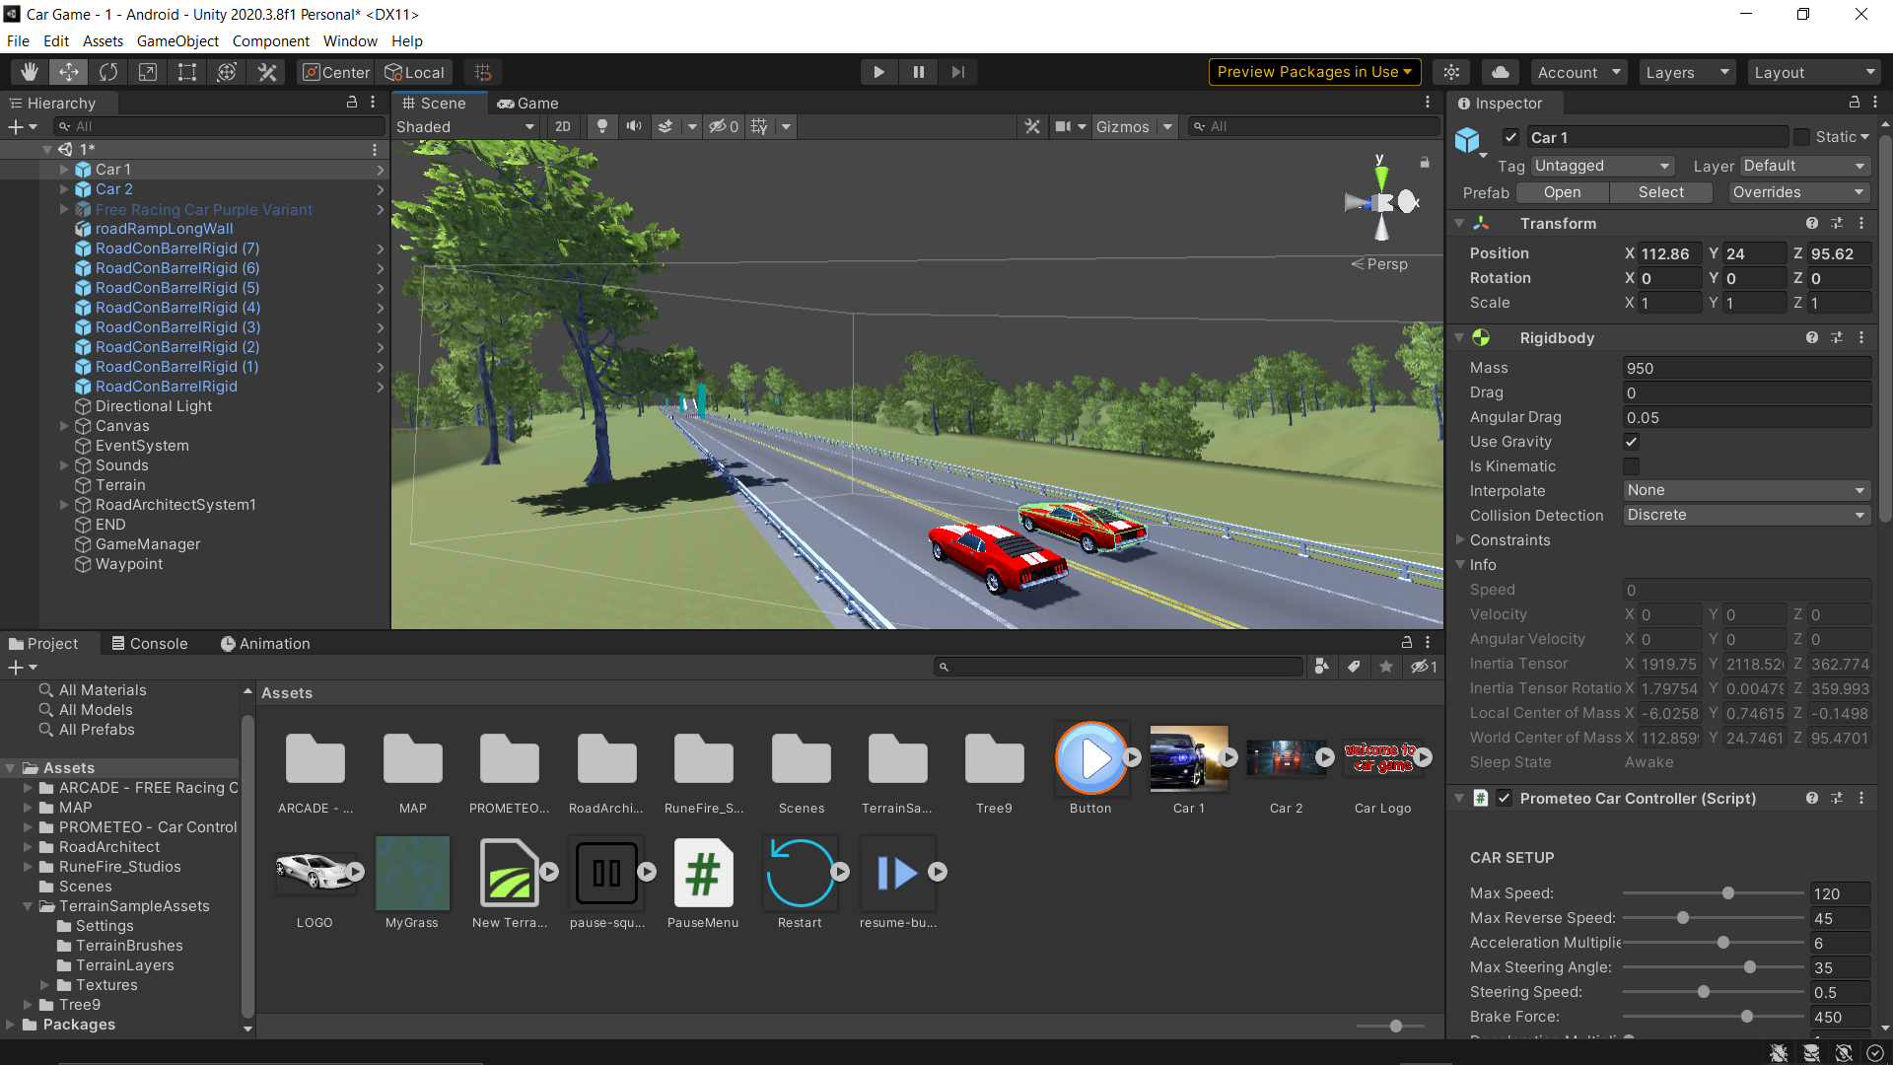
Screenshots of Unity

Slide 8
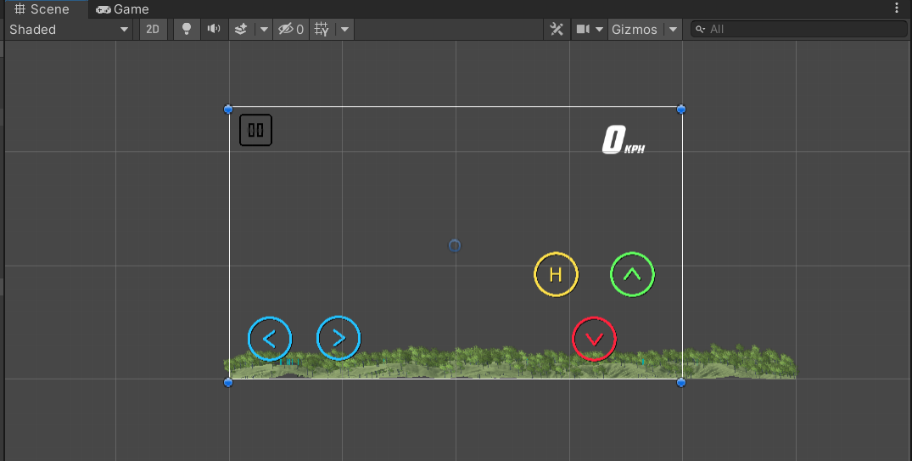
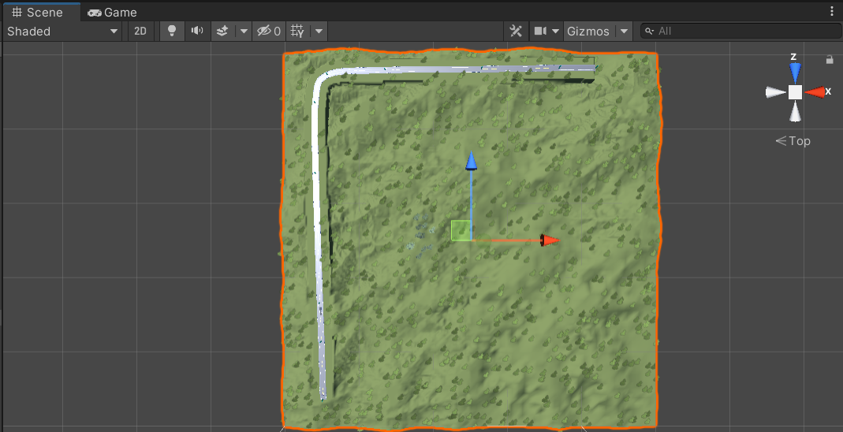

Slide 9
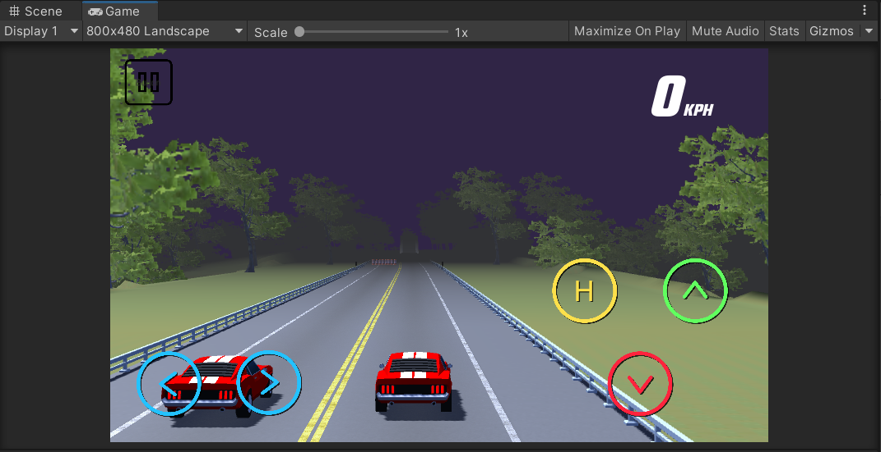

Slide 10
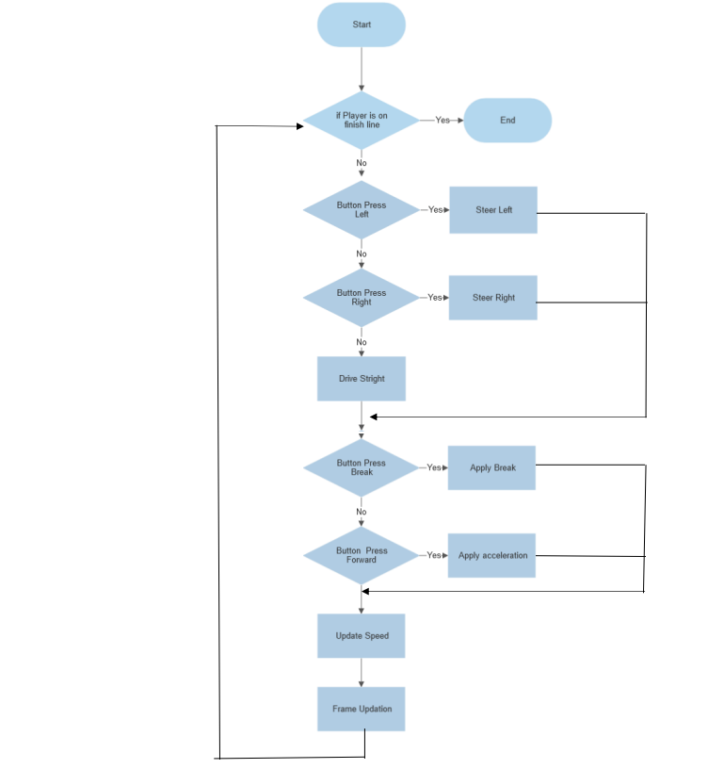
Flow Chart

Slide 11
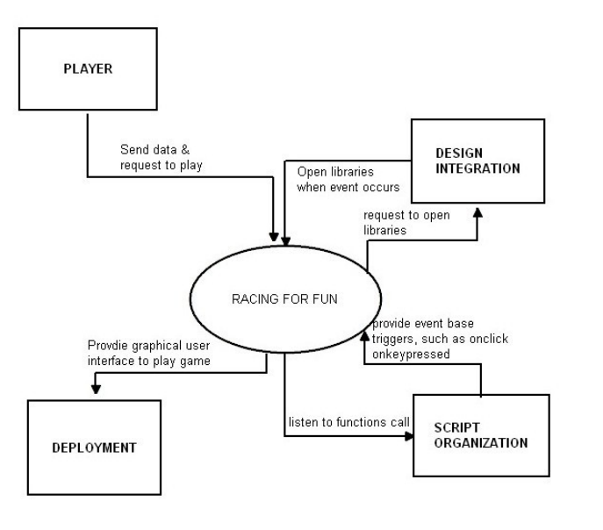
Data Flow Diagram
Level 0

Slide 12
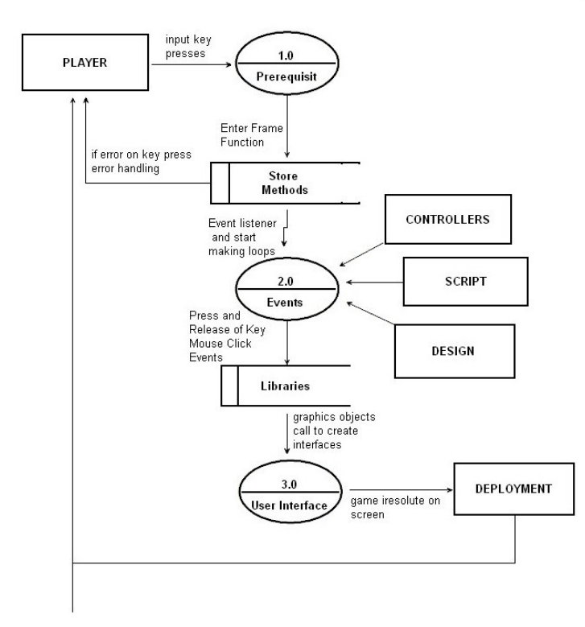

Level 1

Slide 13
Limitations of the project
It does not have a multiplayer gameplay.
It only has one map and car.
It doesn’t have car modification.
It only have 3rd person prospective.

Slide 14
FUTURE SCOPE
I have many scope for developing our Application. I can make this application as multiplayer support. In our application I don’t have car customization and a 1st person view. I can make this happen in future. Making it move attractive so that people will spend more time on it and make a better UI and more fun to play with.

Slide 15
REFERENCE
Unity: - https://assetstore.unity.com/
https://unity.com/how-to/beginner-video-game-resources
YouTube: - https://www.youtube.com/@Brackeys https://www.youtube.com/watch?v=RqomLumqwCk&t=1s
https://www.youtube.com/watch?v=fbcJjZInt-A
and many more.

Slide 16

Thank you

